Slide 1
Anime Predictions
Heather Garcia and Tyler Reed

Slide 2

Challenge
Find a real-world problem that impacts you and use data driven methodologies to find a solution to the problem.
We both have kids that like Anime.
Can we figure out how Otaku rate Anime?
What factors are most common to a high rating (8-10)?
Fairy Tail
Anime
Notes:
Our challenge was for us to find a real world problem that impacted us in some way and use a data driven solution to solve it. Since we both have children that love Anime, we chose to build models to

Slide 3

Challenge Accepted
Otaku
Our Data
Contains information about Anime and Otaku who watch it
Anime is a style of hand-drawn and computer animation originating in, and commonly associated with, Japan
Otaku is a Japanese term for people with obsessive interests, commonly towards the anime and manga fandom
Manga are comics created in Japan or by creators in the Japanese language, conforming to a style developed in Japan in the late 19th century.
Our Challenge
How accurately can we predict a user rating an anime high?

Slide 4

Finding Data
Seven Deadly Sins
Three Datasets
My Anime List
Anime Recommendations Database
Anime Data (Score, Staff, Synopsis, and Genre)
Same Source
Myanimelist.net
Narrow the List
Dataset: My Anime List
Anime
Notes:
Initially we found three datasets on Kaggle. They all came from the same source, Myanimelist.net. We chose to use the My Anime List dataset because it was the largest by far.

Slide 5

Initial Challenges
Fullmetal Alchemist
Dataset Versions
Original
Cleaned
Filtered
Large Volumes
One file contained over 64M records
Our poor machines couldn’t keep up!
Fix: read file 2000 rows at a time, randomly pick 20
Manga
Notes:
There were 3 versions of the dataset to use. Original, Cleaned and Filtered. So we could practice our data cleaning skills, we chose to use the original set. In this dataset, there were 64 million records. It was too large for our computers. Because of its large size, however, we felt confident we could sample it instead. We read in 2000 rows at a time and randomly picked 20 to use.

Slide 6

Search for Predictors
One Piece
Initial Scrub: Process of Elimination
Columns that are a repeat of each other
Title, Japanese Title
ID Columns
Text Mining
No Documentation
Near Zero Variance
Manga
Notes:
To begin with, we started eliminating columns. There were columns that were had redundant info such as 4 different ways to record the anime title. We removed the ID columns and any column that didn’t have any documentation.

Slide 7
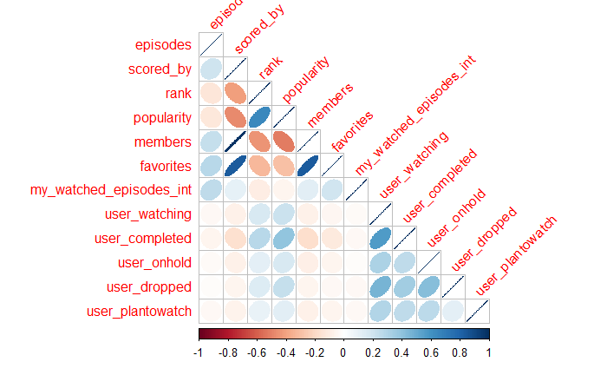
Data Exploration and Preprocessing
Skewness?
Near Zero Variance?
Continuous vs. Categorical Predictors?
Categorical - How Many Levels?
Correlation?
Categorical | Continuous
13 | 13
Notes:
After scaling for skewness and testing for NearZeroVariance, we ended up with 26 columns. 13 categorical and 13 continuous. The categorical variables had many levels, so we had to clean it some more.

Slide 8
Data Cleaning
Several categorical predictors had many different categories. We binned them in ways that made sense and were easier to work with.
Dates - binned into years; before 2009, 2009 to 2012, & 2012 to present.
Gender - binned into Male, Female and non-binary.
Duration - 1-20 mins, 21-40 mins, 41-60 mins, etc.
Related - Adaptations, Relatives, Alternatives, other.
Broadcast - binned into days of the week; Sunday, Monday, etc.
Producer, Studio, Licensor - binned by count, High & Low.
My_score (response) - binned by score; 8-10 = High, 7 and below = Low.
Notes:
We removed any My_scsore with a 0. For Rank, we removed 17 of the rows with missing data. We binned several others in ways that made sense and that made them usable.

Slide 9

Feature Selection
Fullmetal Alchemist: Brotherhood
Stepwise AIC
Direction = Both
Logistic Regression
Final Features
Source of the anime | rank | Rating | gender
Length of show | popularity | User on hold fromwatch | favorites
User stopped watching | Day of the week show is on | User planned to watch
Score of anime | User Watching | Last year user online
Number of member scored the anime | User completed watching | Year User joined site
Anime
Notes:
We then ran a Logistic Regression model using Stepwise AIC going both ways to finalize which features to use.
Output from StepAIC
".outcome" "anime_srcManga"
"anime_srcOther" "anime_lenmovie"
"rateR+" "score"
"scored_by" "rank"
"popularity" "favorites"
"user_watching" "user_completed"
"user_onhold" "user_dropped"
"user_plantowatch" "lst_online_yrBefore 2018"
"lst_online_yrNot Reported or 1900" "join_yrLate"
"gnd_grpNon-Binary" "broadcastedSunday"

Slide 10

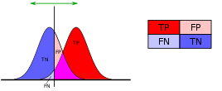
Model Accuracy
Sword Art Online
Our Choice: Sensitivity
Anime
Notes:
Since our goal is to predict which users would rate anime high, we concentrated on Sensitivity as our accuracy metric. We even set our models to be more sensitive so more True Positives could be indentified.

Slide 11
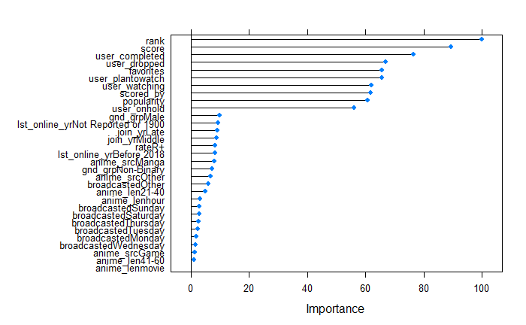
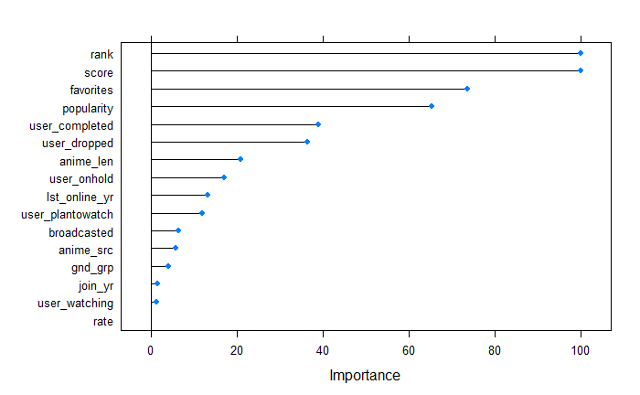
Model Tuning, Training Results
Random Forest
Mtry = 14
Sensitivity = 71.78%
Also to note: 6, 71.32%
K-Nearest Neighbor
K = 48
Sensitivity = 73.76%
Notes:
We trained the data with 4 models - Random Forest, K-Nearest Neighbor, Logistic Regression and L

Slide 12
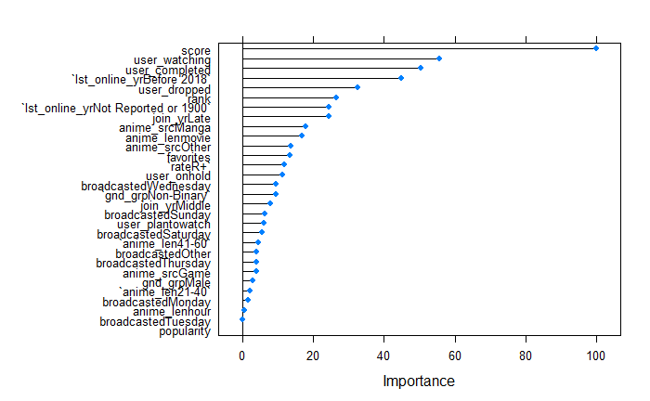
Model Tuning, Training Results
Logistic Regression
Sensitivity = 71%
LDA
Sensitivity = 73.09%

Slide 13
Accuracy forecasting
Random Forest best model accuracy:
Perdiction | High | Low
High | 1558 | 747
Low | 691 | 1337
69.28%
K-Nearest Neighbor best model accuracy:
Perdiction | High | Low
High | 1626 | 941
Low | 623 | 1143
72.3%

Slide 14
Accuracy forecasting continued
LDA best model accuracy:
Perdiction | High | Low
High | 1607 | 846
Low | 642 | 1238
71.45%
Logistic Regression best model accuracy:
Perdiction | High | Low
High | 1544 | 761
Low | 705 | 1323
68.65%

Slide 15
Final Model Choice
Model | Predicted Accuracy
Random Forest | 69.3
K-Nearest Neighbor | 72.3
LDA | 71.5
Logistic Regression | 68.7

Slide 16

Takeaways
Used more than just the user info to predict ratings
When using such a large dataset, it's better to take a sample.
Data cleaning is essential and will probably take most of your time and effort.

